Slide 1


Project arduino based vechile accident alert AND DeTECTION system
BY
19881A1231 M S Sayi Shesshank
19881A1205 Bandari Manoj Kumar
19881A1233 Manchala Venkatesh
19881A1235 M Sai Dattu
5. 19881A1221 korra srinu

Slide 2
Abstract
The main objective of our project is to provide an optimum(best) solution to the traffic hazards and the road accidents.
According to this project when a vechile meets with an accident,immediately vibration sensor will detect the signal and sends it to ARM(Advanced RISC Machine) controller
[where RISC is Reduced instruction set computing]

Slide 3
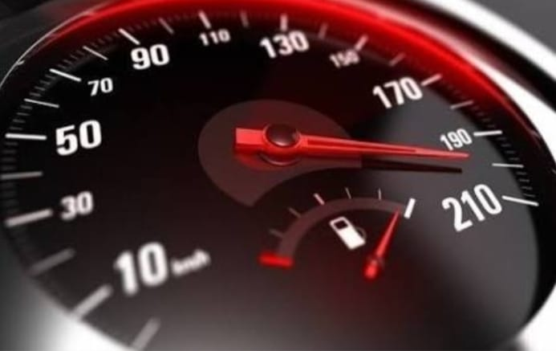


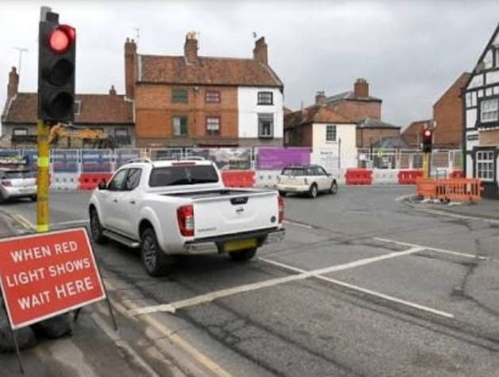

Main Causes of road accidents
Overspeeding
Drunken driving
Distractions to driver
Red light jumping
Avoiding safety gears (wearing seat belt,helmets)

Slide 4
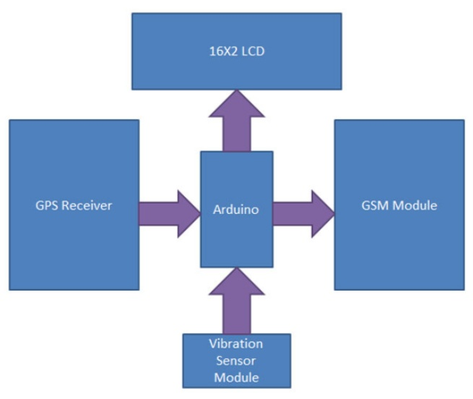
Introduction
Arduino is interfaced with piezo electric sensor to detect the Accidents.
GSM is interfaced to Arduino to send notification messages to Authorized Users.
Buzzers is interfaced with Arduino to alert accidents.

Slide 5
How it works
Accident Detection and Messaging System is easy and the components used are Vibration Sensor, which detects the accident and in turn sends the signals to Arduino.
At this point the Arduino takes control and starts collecting the coordinates received from the GPS which are later sent to the Central Emergency Monitoring Station by using the GSM Module.

Slide 6
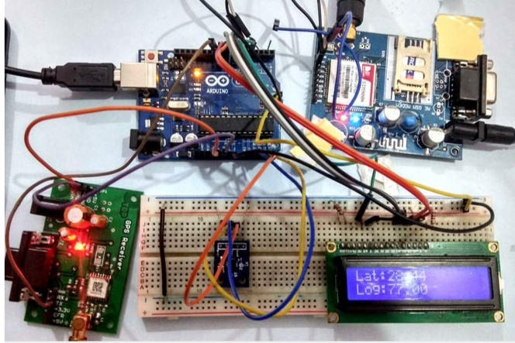
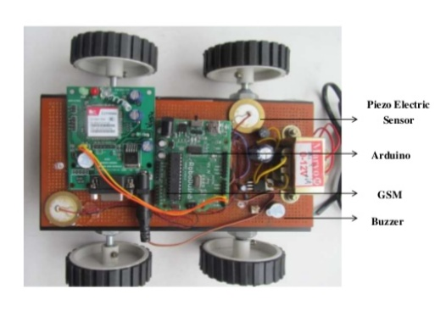
Models Developed

Slide 7
Development of Prototype
Circuit Connections of this Vehicle Accident Alert System Project,Here Tx pin of GPS module is directly connected to digital pin number 10 of Arduino. By using Software Serial Library here, we have allowed serial communication on pin 10 and 11, and made them Rx and Tx respectively and left the Rx pin of GPS Module open. By default Pin 0 and 1 of Arduino are used for serial communication but by using the SoftwareSerial library, we can allow serial communication on other digital pins of the Arduino. 12 Volt supply is used to power the GPS Module.
GSM module’s Tx and Rx pins of are directly connected to pin D2 and D3 of Arduino. For GSM interfacing, here we have also used software serial library. GSM module is also powered by 12v supply. An optional LCD’s data pins D4, D5, D6, and D7 are connected to pin number 6, 7, 8, and 9 of Arduino. Command pin RS and EN of LCD are connected with pin number 4 and 5 of Arduino and RW pin is directly connected with ground. A Potentiometer is also used for setting contrast or brightness of LCD.
An Accelerometer is added in this system for detecting an accident and its x,y, and z-axis ADC output pins are directly connected to Arduino ADC pin A1, A2, and A3.

Slide 8

Links Of Science & Engineering Concepts
IOT(Internet of Things) Applications
ITS(Intelligent Transportation System)
ICT(Information & Communication Technologies)

Slide 9
Components Used
Arduino Uno
GSM Module (SIM900A)
GPS Module (SIM28ML)
Accelerometer (ADXL335)
16x2 LCD
Connecting Wires
10 K-POTBreadboard or PCBPower
supply 12v 1amp

Slide 10
Outcomes
The main aim of this project is to construct an Arduino Based Vechile Accident Alert system with minimizing the limitations of existing methods and also enhancing the security of vehicles and human beings and also reduces the accidental injuries.
Arduino Based Vechile Accident Alert system will entail a speed and other parameters of vehicle sensing

Slide 11
References
Bestengineeringprojects.com
Engineersgarage.com
Circuitdigest.com
Create.Arduino.cc
wikipedia

Slide 12


Slide 13


